Slide 1

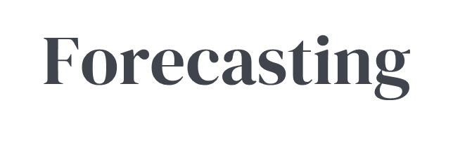
Our approach to client hardware forecasting involves collaboration between customers, vendors, and Softchoice. We leverage data-driven insights and industry expertise to provide accurate and actionable forecasts.
Forecasting will help our your organization make informed decisions based on historical data, vendor road mapping, and allow you to stay ahead of your competition.

Slide 2












Forecasting
Benefits
Cost effective
Free Storage
No need to purchase upfront
Plan
Hold regular meetings to understand customers hardware needs in the next 30 / 60 / 90 days
Limit risk of vendor delays
Acquire
Procure from the preferred vendor on the customers behalf
Fast turnarounds
Store
Warehouse the equipment for up to 60 days without storage fees
Consistent delivery timelines
Large secure warehouse facility
Report
Weekly report providing quantities, product description, and age
Product visibility
Deploy
Upon customer request, we can image and ship or pick, pack and ship based on customers PO
Smoother product transitions

Slide 3

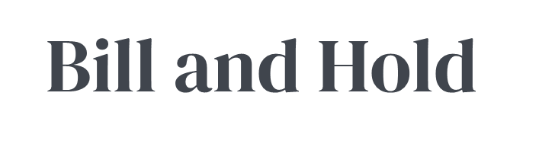
Our value-add warehousing service is designed for Softchoice customers who need a reliable solution for storing and managing their inventory. If our customer has a specific business requirement for warehousing and need to place bulk purchase orders, this service is just what they need.

Slide 4
Bill and Hold Warehousing
Benefits
Convenience: Simplifies your inventory management and logistics.
Reasons to enter a Bill and Hold Agreement
Reliability: Ensures your products are stored safely and delivered on time.
Lack of physical space:
When you do not have enough storage space, a Bill and Hold Agreement allows you to purchase the goods and have Softchoice store them until needed to deploy.
Scalability: Adapts to your business needs, whether you have a small or large inventory.
Bulk purchase for future requirements:
If you want to take advantage of bulk purchase discounts or ensure they have enough inventory for future business demands without immediately needing storage space.
Secured Budget: Avoid the risk of fluctuating costs and lock in pricing to help with financial planning.
Avoid lead time delays:
Having inventory readily available, you can respond quickly to order requirements, reducing the risk of delays due to productions or shipping timelines.
Consistent delivery timelines
Secure constrained products:
Items that are in high demand or have limited availability, securing inventory ensures that your inventory requirements has the necessary products required for your business when needed.
Important!
Bill and Hold Agreements are invoiced once the inventory is physically available in the warehouse, and you take ownership.
Storage fees are based on the quantity and duration warehousing associated with holding the inventory.
Large secure warehouse facility

